Slide 1
Making a Math Website
As an Emory math graduate student,
with focus on HMTL, Google Sites, or GitHub
Disclaimer: These are some popular options I have seen, and I can show some basic principles I’ve learned, but there are infinitely more ways to do this that I don’t know about. I hope these basic outlines will be helpful.

Slide 2
Get Inspiration
Perhaps the most effective website-making strategy I have seen is to find one you like, and essentially copy it
This is an extremely well-respected strategy in the mathematics community, as far as I can tell
Looking at examples is a great way to figure out what is important to you. What did you like? What didn’t you like?

Slide 3
Examples: HTML, hosted by Emory
David Borthwick: https://www.math.emory.edu/~davidb/
Julianne Chung: https://www.math.emory.edu/~jmchung/
Alessandro Veneziani: https://www.math.emory.edu/~ale/
Yuanzhe Xi: https://www.math.emory.edu/~yxi26/
Nat Milnes: https://www.math.emory.edu/~nmilnes/
Emma Hart: https://www.math.emory.edu/~ehart5/

Slide 4
Examples: Google Sites
Neha Gupta: https://sites.google.com/site/nehagupta15/
Matthias Chung: https://sites.google.com/view/matthias-chung/
Lucas Onisk: https://sites.google.com/view/lucas-onisk/
Matthew Allen: https://sites.google.com/view/matthew-allen/
Griffin Johnston: https://sites.google.com/view/griffins-webpage/

Slide 5
Examples: GitHub
Elle Buser: https://ellebuser.github.io/
Mitchell Scott: https://mtscott.github.io/
Michael Zheng: https://mx-xz.github.io/

Slide 6


Choosing which option to use
EHCU Ratings
Ease of Use
Customizability
HMTL
GitHub
Google Sites
In an hour with no experience
With a lot of time/experience
Google Sites
GitHub
HMTL
Other Factors and Considerations:
Permanence of the URL
Cost of a nice URL
Pride and/or showing off
Needing an account
Search Engine Optimization???

Slide 7
HTML:
Create HTML file(s) and edit locally
Working from a template makes this much easier! If you choose a structure that you like already, then edit text/images, it is a more straightforward process
You can test out your site locally by opening the HTML file in Chrome/other
Email Edgar Leon and ask for a home directory (starting September 30)
Transfer your files to home/NETID/sunhome/share/public_html
Check http://math.emory.edu/~NETID to make sure things look ok
Contact Terry about including your URL on the math site
Update with vim or by re-transferring local files
MUCH more detailed instructions at the end of this presentation

Slide 8

Google Sites:
https://sites.google.com/view/emory-website-session-sample?usp=sharing
Create a new Google Site (kind of like PowerPoint UI)
Choose domain options and publish
Contact Terry about including your URL on the math site
To update your website, edit with the same UI and publish on Google Sites (no other step necessary!)

Slide 9
GitHub:
Create a new GitHub repository, and name it USERNAME.github.io
Create HTML or Markdown or Other files
Markdown is more lightweight than HTML, can be more intuitive and less intensive to learn
Again, working from a template can make it even easier
Check USERNAME.github.io to make sure things look ok
Contact Terry about including your URL on the math site
To update, make and commit changes to the repository (no other step necessary!)

Slide 10
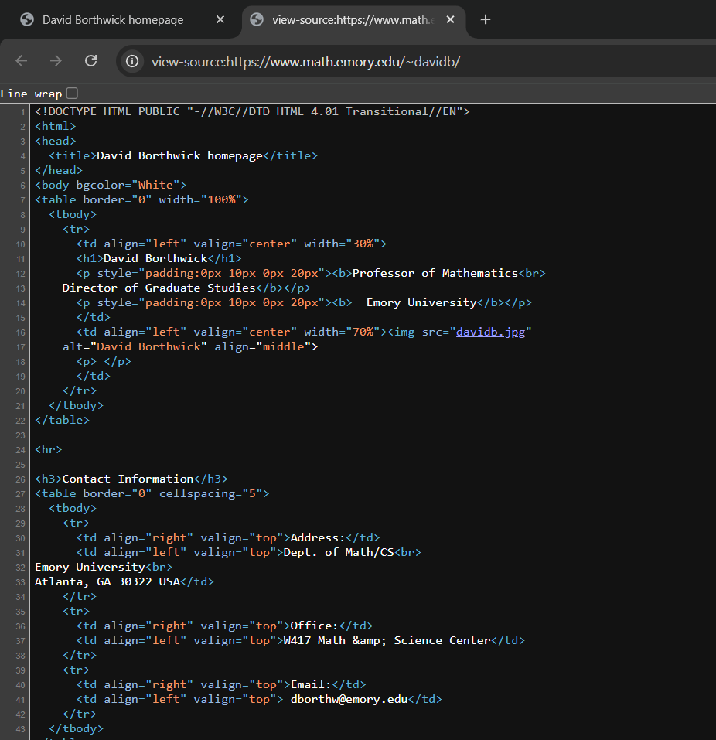
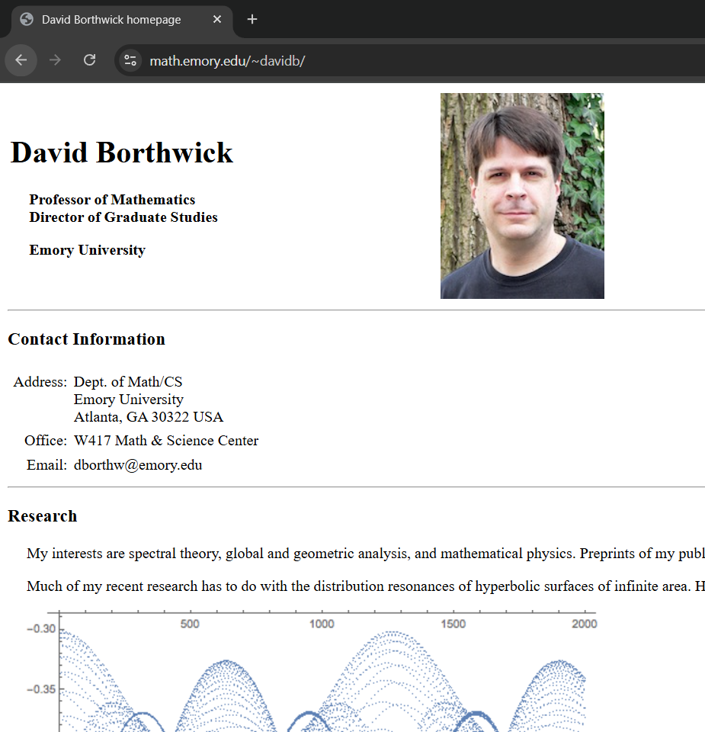
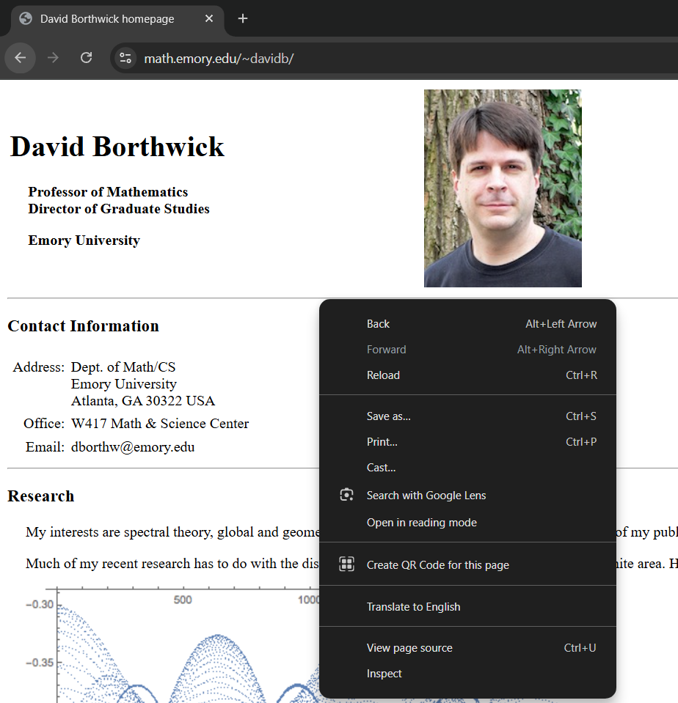
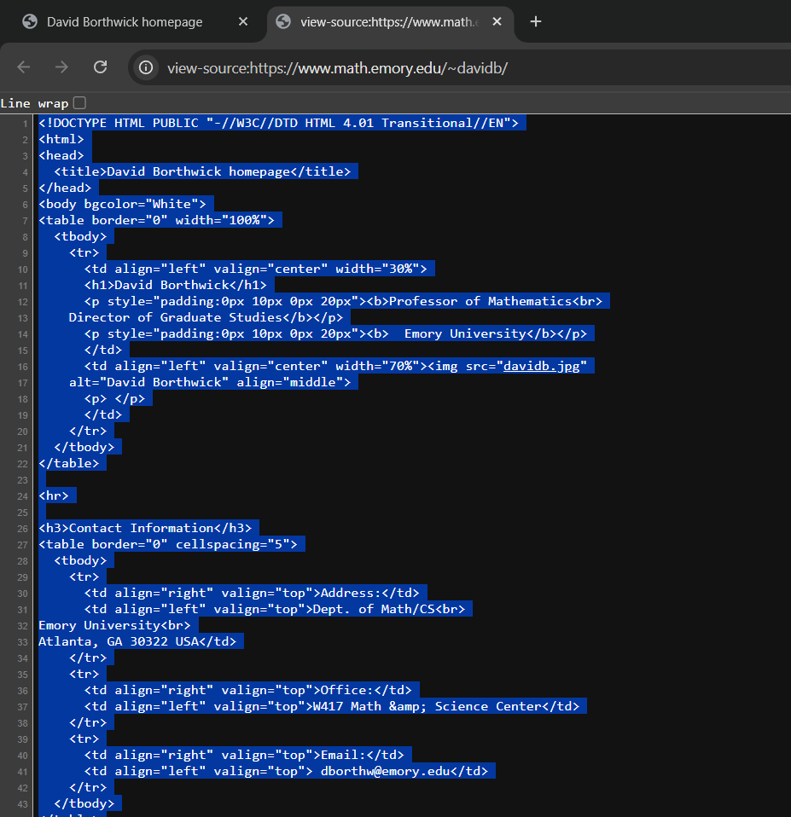
A Detailed Guide to Stealing Dr. David Borthwick’s Website*
In Chrome, navigate to https://www.math.emory.edu/~davidb/
Right click and select “View Page Source”
Copy all the lines of HMTL, (Windows: ctrl+a, ctrl+c, Mac: cmd+a, cmd+c)
*Be sure to ask/credit him before publishing.

Slide 11
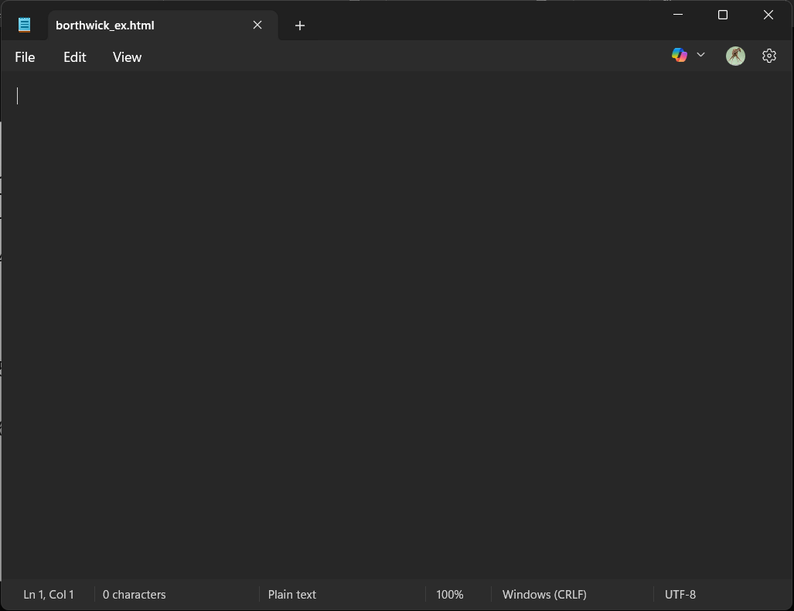
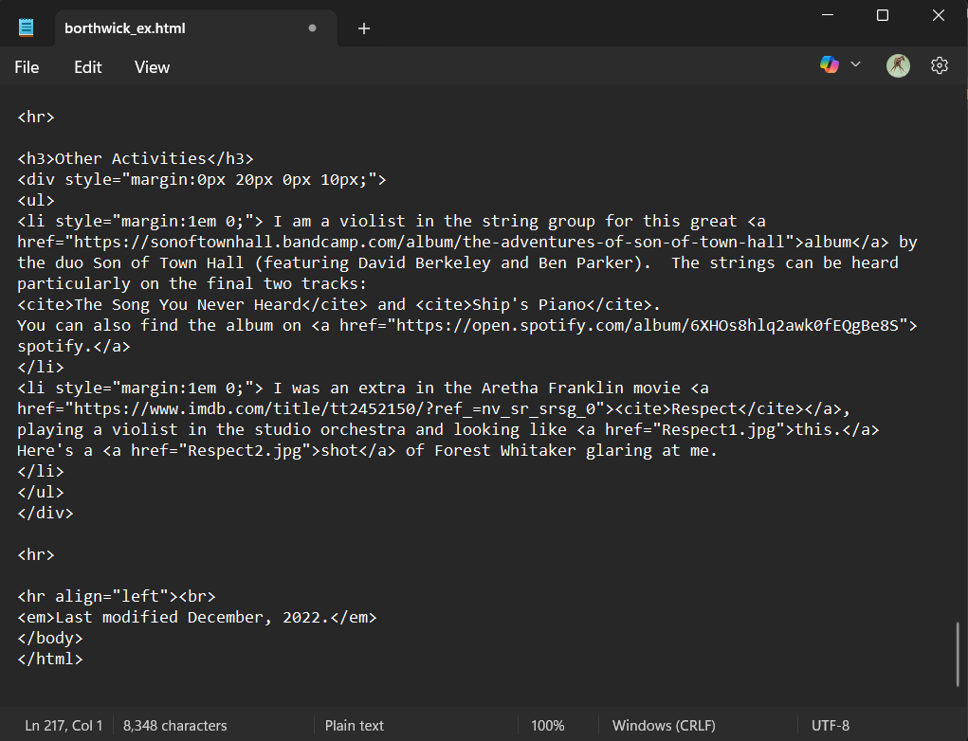
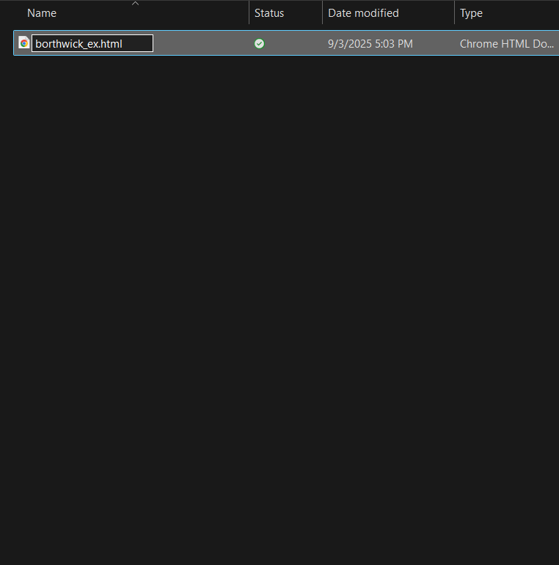
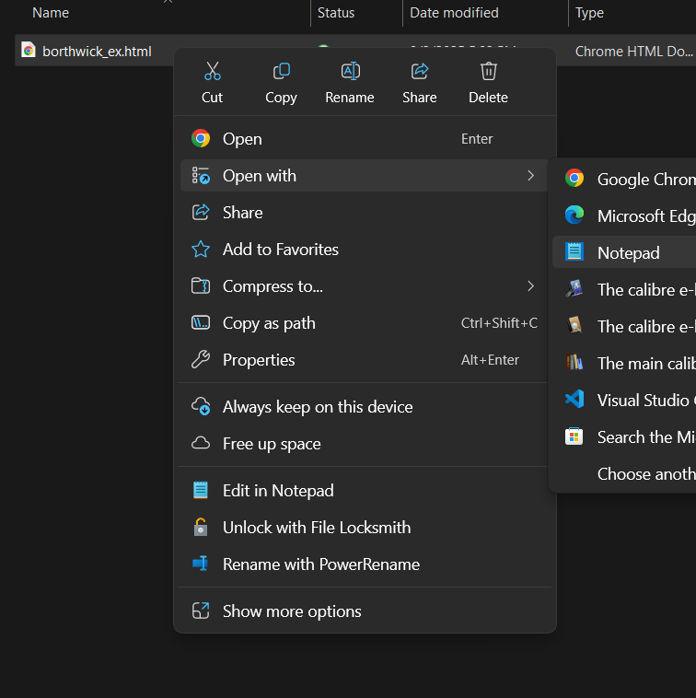
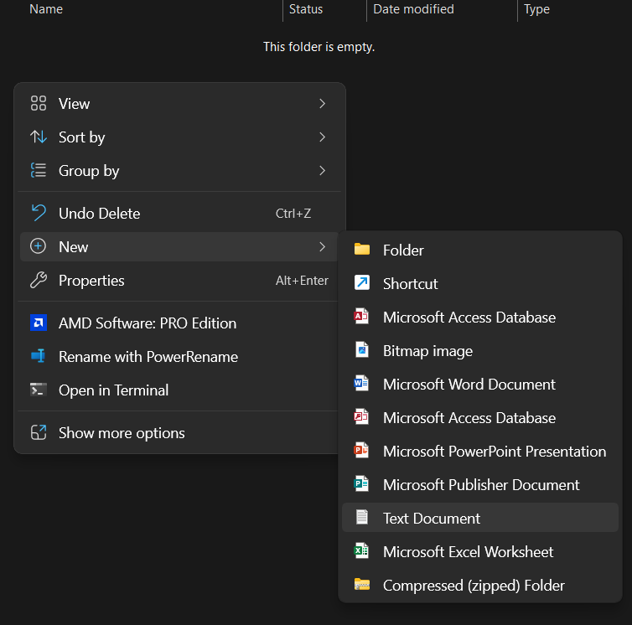
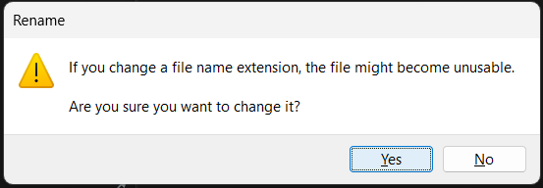
A Detailed Guide to Stealing Dr. David Borthwick’s Website*
Create a new folder and a new .html file in that folder (ex: folder “Website Tutorial”, file “borthwick_ex.html”)
Open the .html file in some text editor (ex: Notepad, VScode)
In that text editor, paste the HTML that you copied and save (Windows: ctrl+v, ctrl+s, Mac: cmd+v, cmd+s)

Slide 12
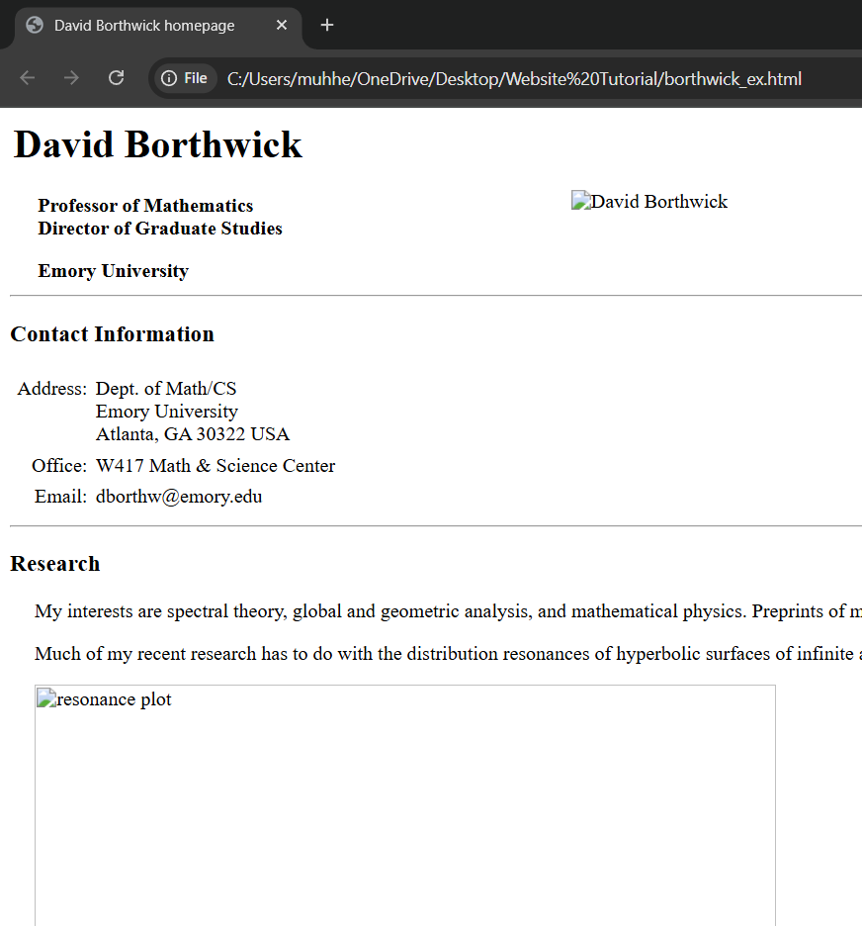

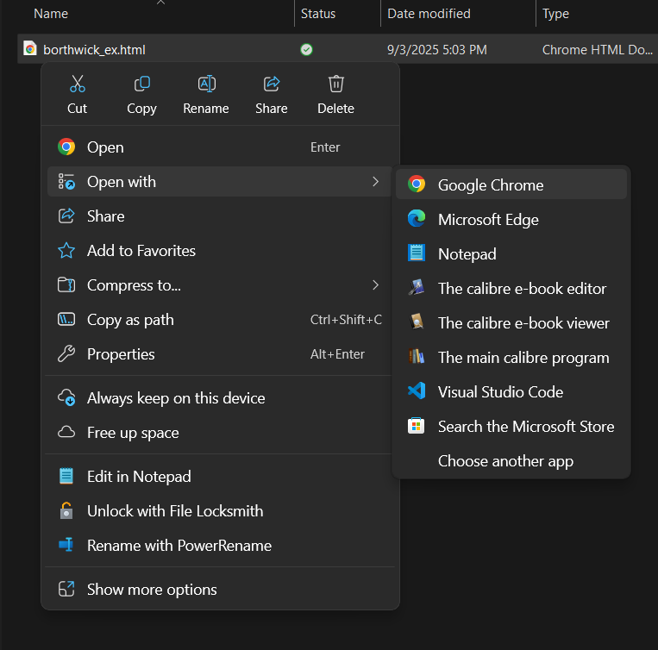
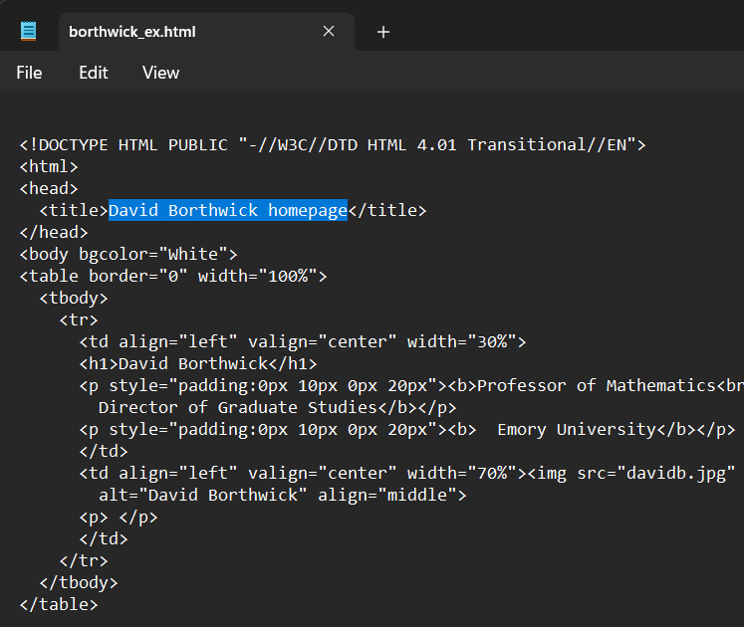
A Detailed Guide to Stealing Dr. David Borthwick’s Website*
See what your website looks like by opening your .hmtl file in Chrome
In your .html file, make some changes (ex: “David Borthwick homepage” to “Your Name”). Save.
Back in chrome, reload the page to see your change

Slide 13
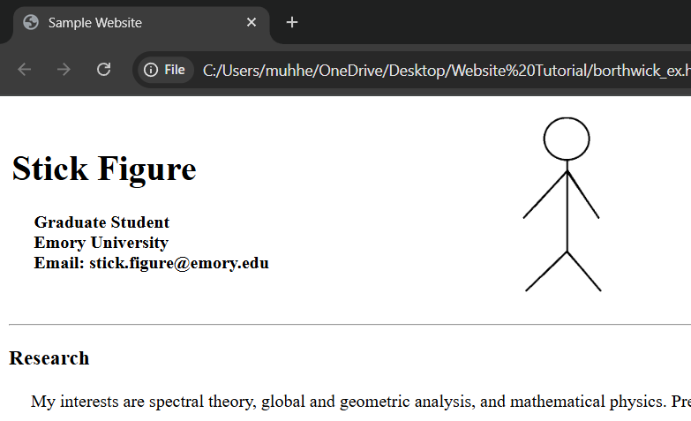
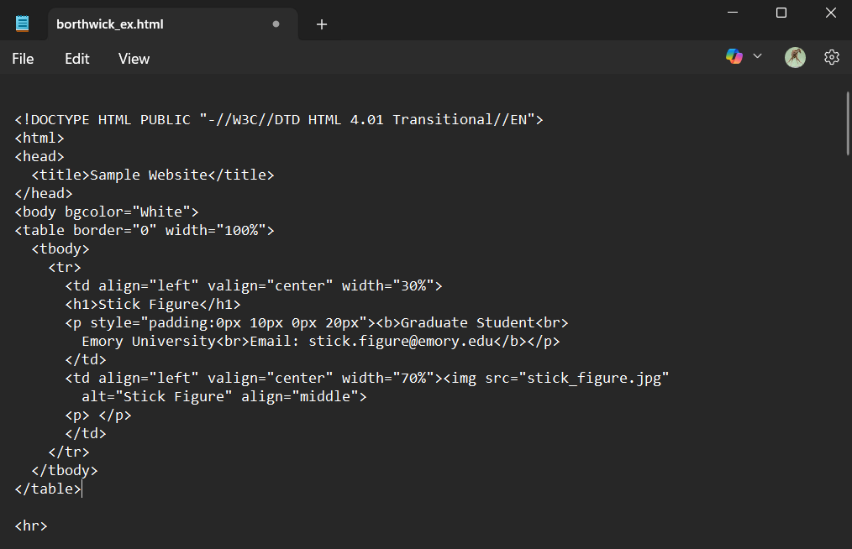
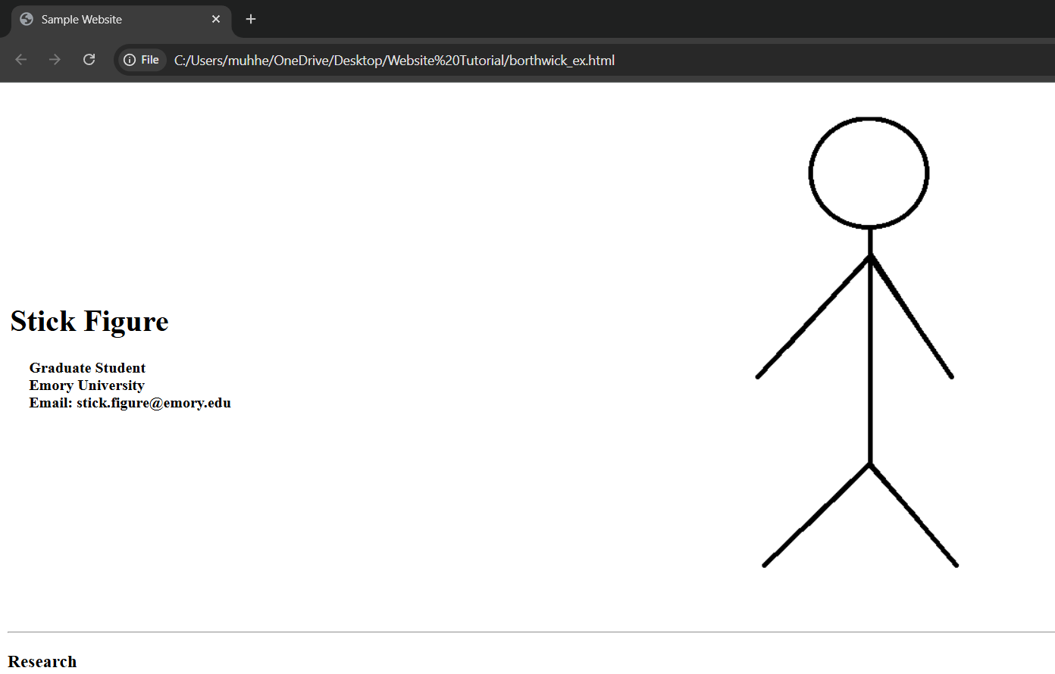
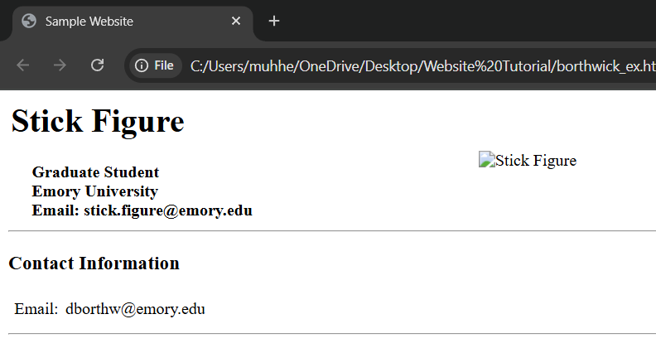
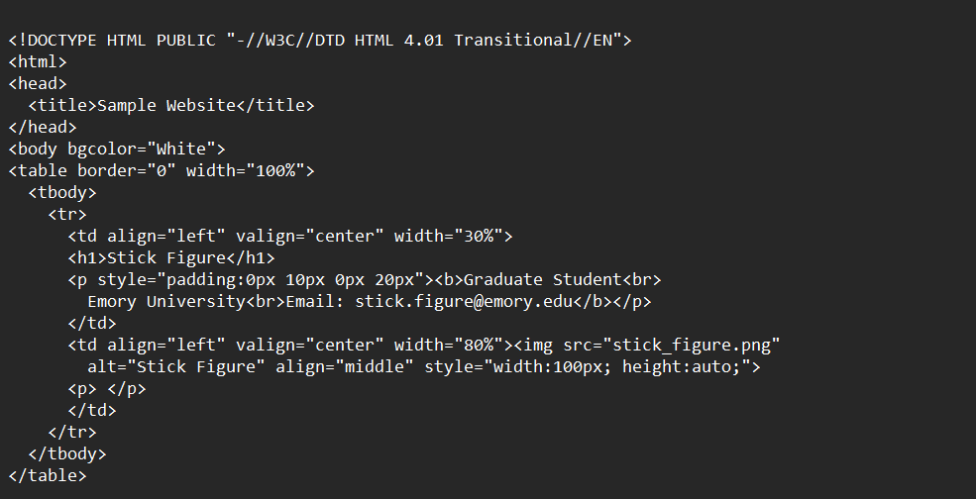
A Detailed Guide to Stealing Dr. David Borthwick’s Website*
Make some other changes, save, and reload in Chrome to check your progress.
You can replace the picture simply by including the picture file in your folder, and changing “davidb.jpg” to the name of your picture.
Play around!

Slide 14
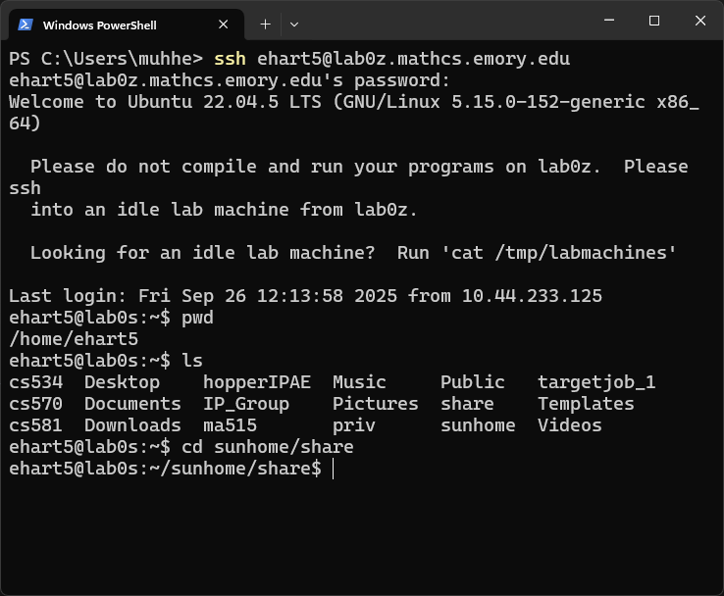
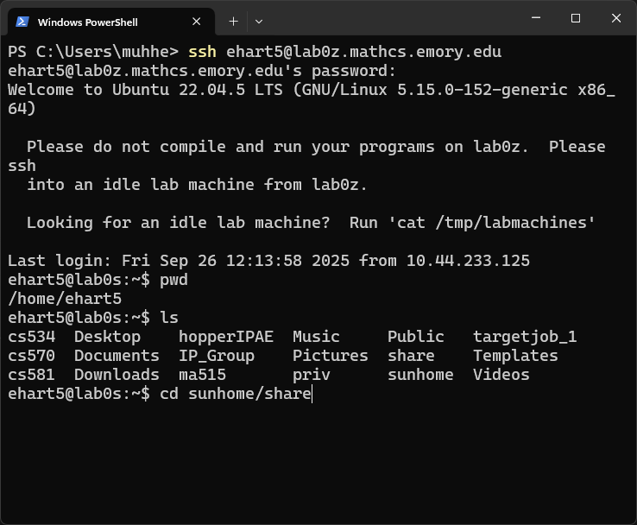
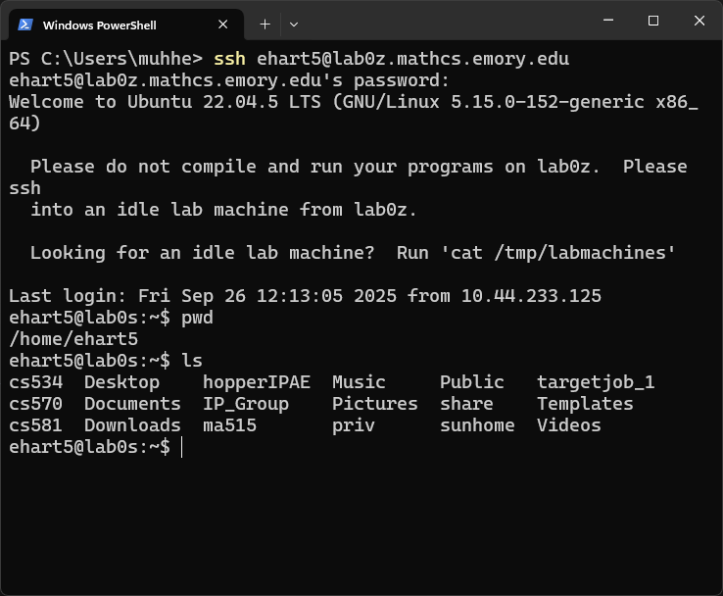
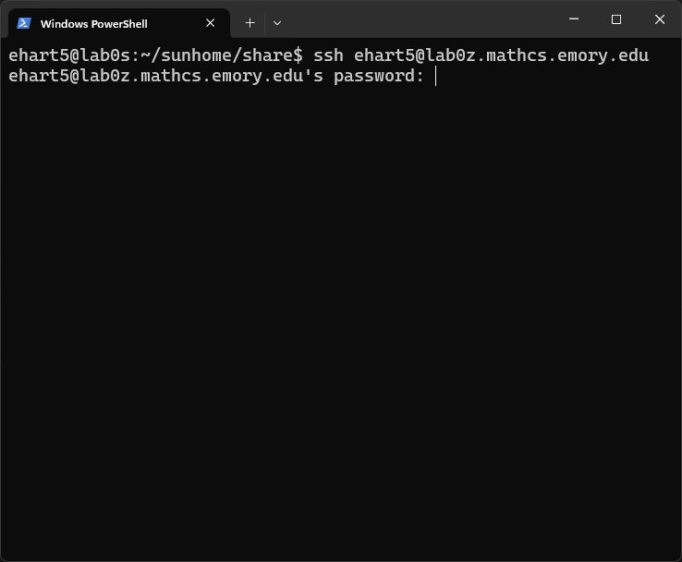
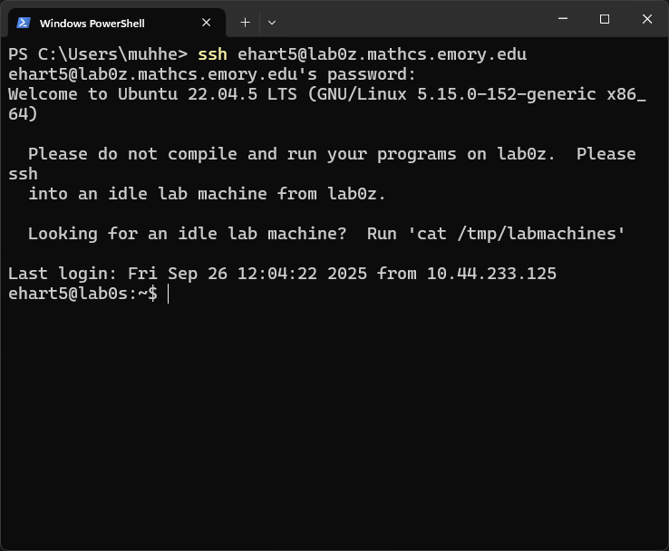
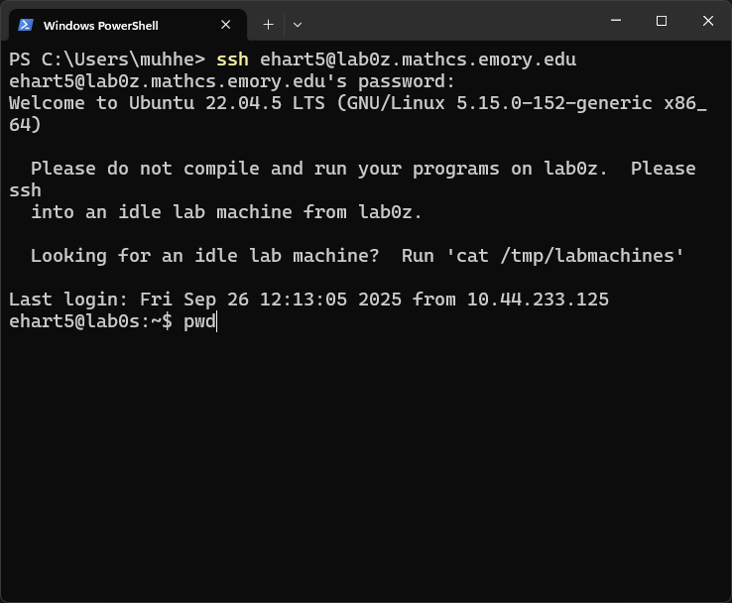
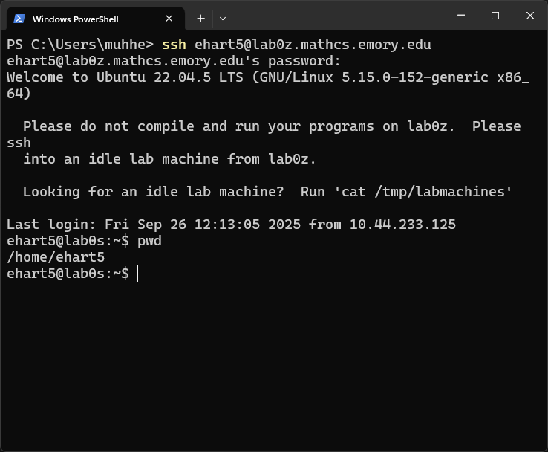

A Detailed Guide to Stealing Dr. David Borthwick’s Website*
Once things are as you like, ssh to server (need home directory)
ssh NETID@lab0z.mathcs.emory.edu
See what folder you are in
pwd
List everything in folder
ls
16. Change directory to sunhome/share
cd sunhome/share
Your website should be placed here in a folder called public_html

Slide 15
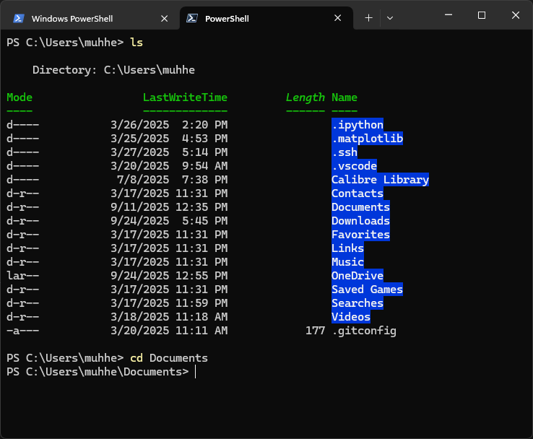
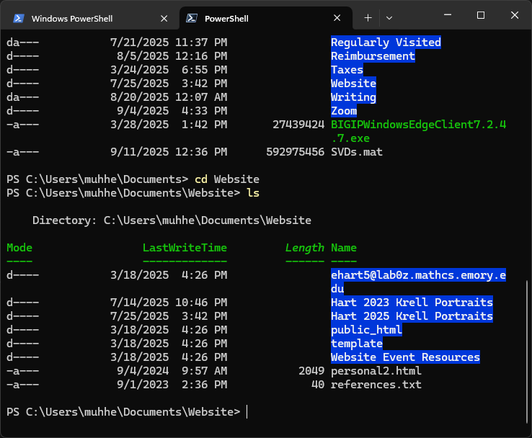
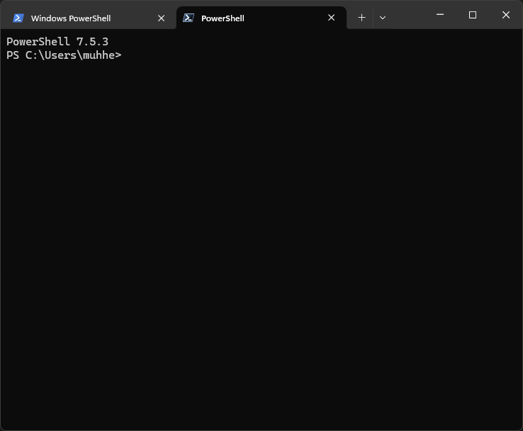
A Detailed Guide to Stealing Dr. David Borthwick’s Website*
Open a new terminal session locally
Use pwd, cd, and ls commands to navigate until you see the folder containing your website.
Be sure that you have named your folder public_html and that your homepage is named index.html
Copy this folder to the correct folder in your home directory on the server using the scp command:
scp –r public_html NETID@lab0z.mathcs.emory.edu:/home/NETID/sunhome/share/

Slide 16
A Detailed Guide to Stealing Dr. David Borthwick’s Website*
Check http://math.emory.edu/~NETID to see if things are working
To update your website, you can use rm to delete the current folder, and follow the same steps as before to reupload an updated website. Make sure you keep local copies safe!
rm –r public_html
Debug with me, Michael, Varun, Sergio, or Edgar
☺

